Slide 1
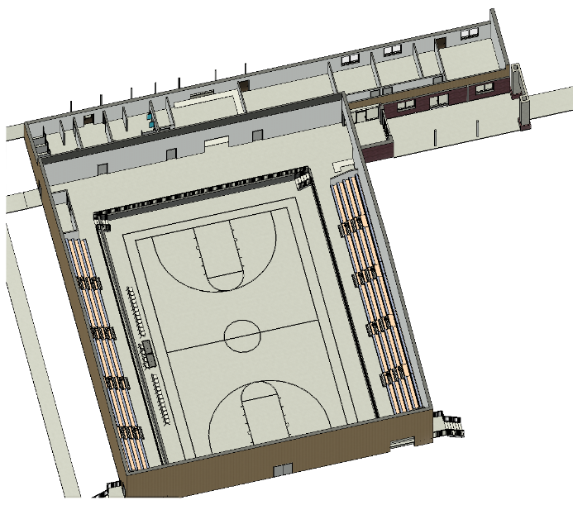
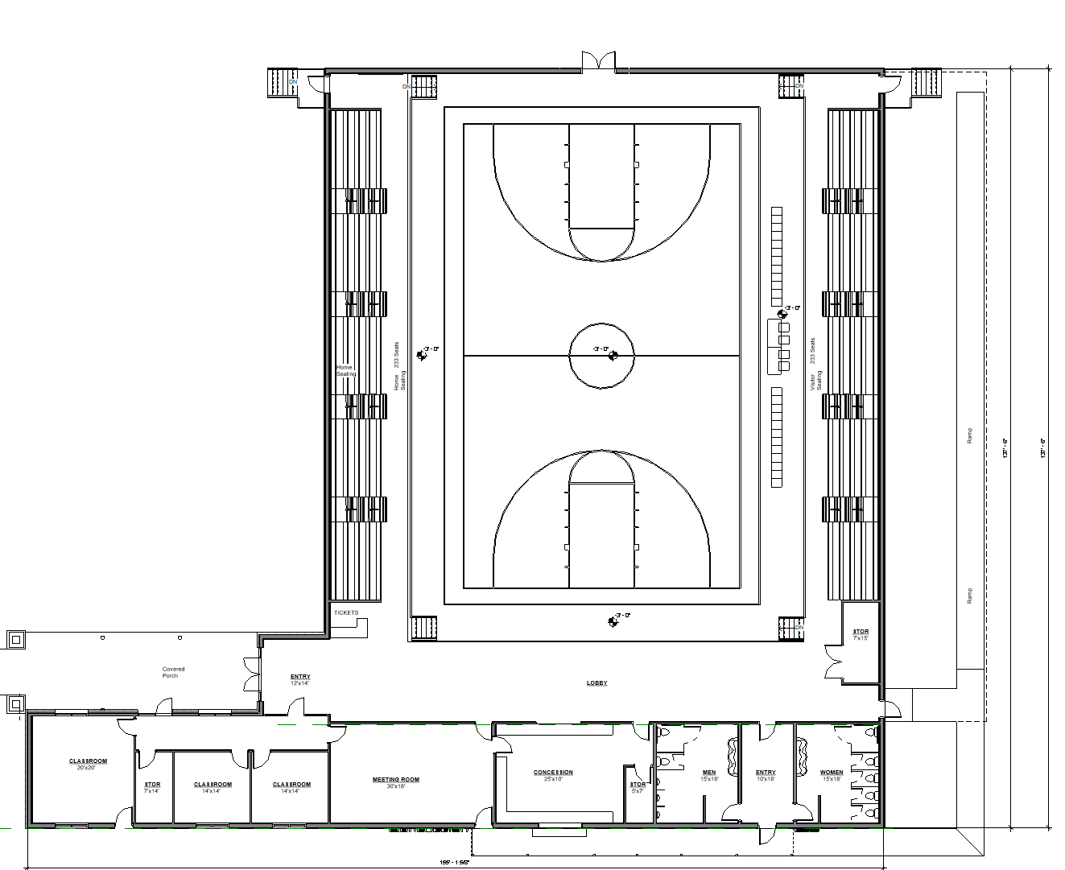
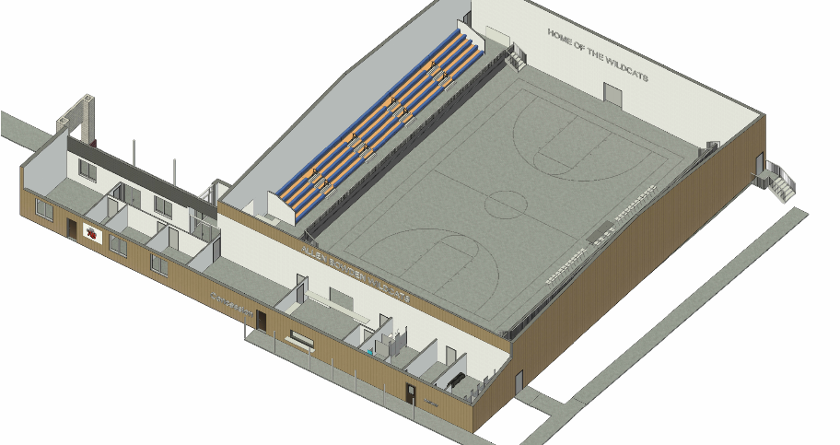
600 seats
Allen Bowden
Classroom/Dressing Rooms
Concession & Restrooms

Slide 2
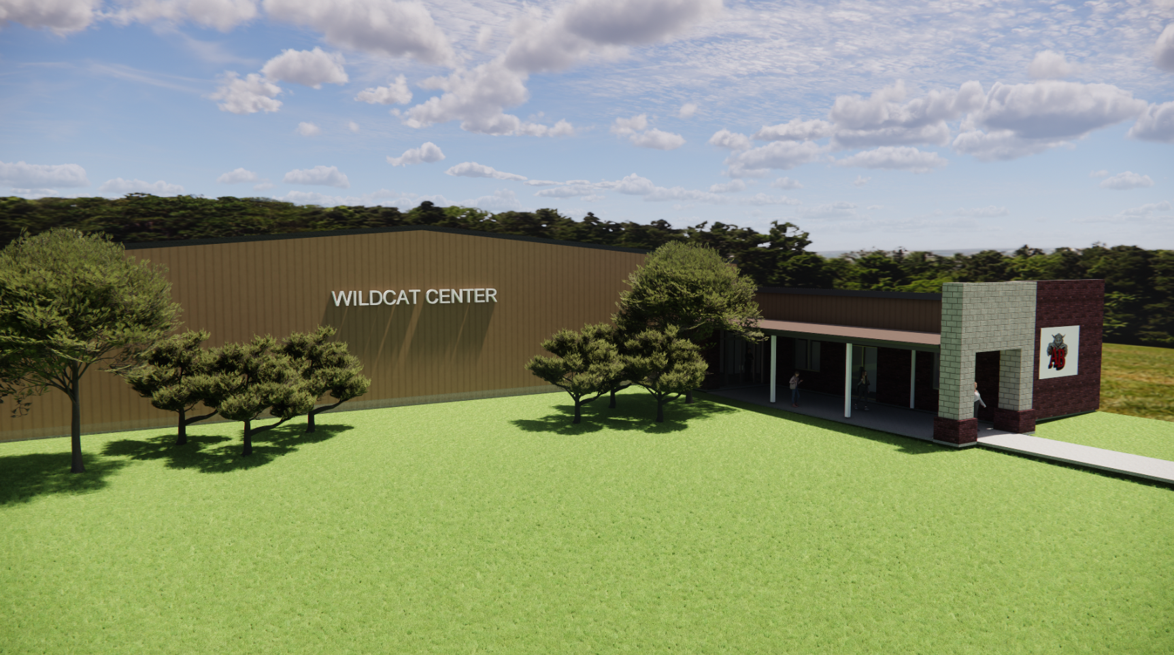
Allen Bowden Activity Center

Slide 3
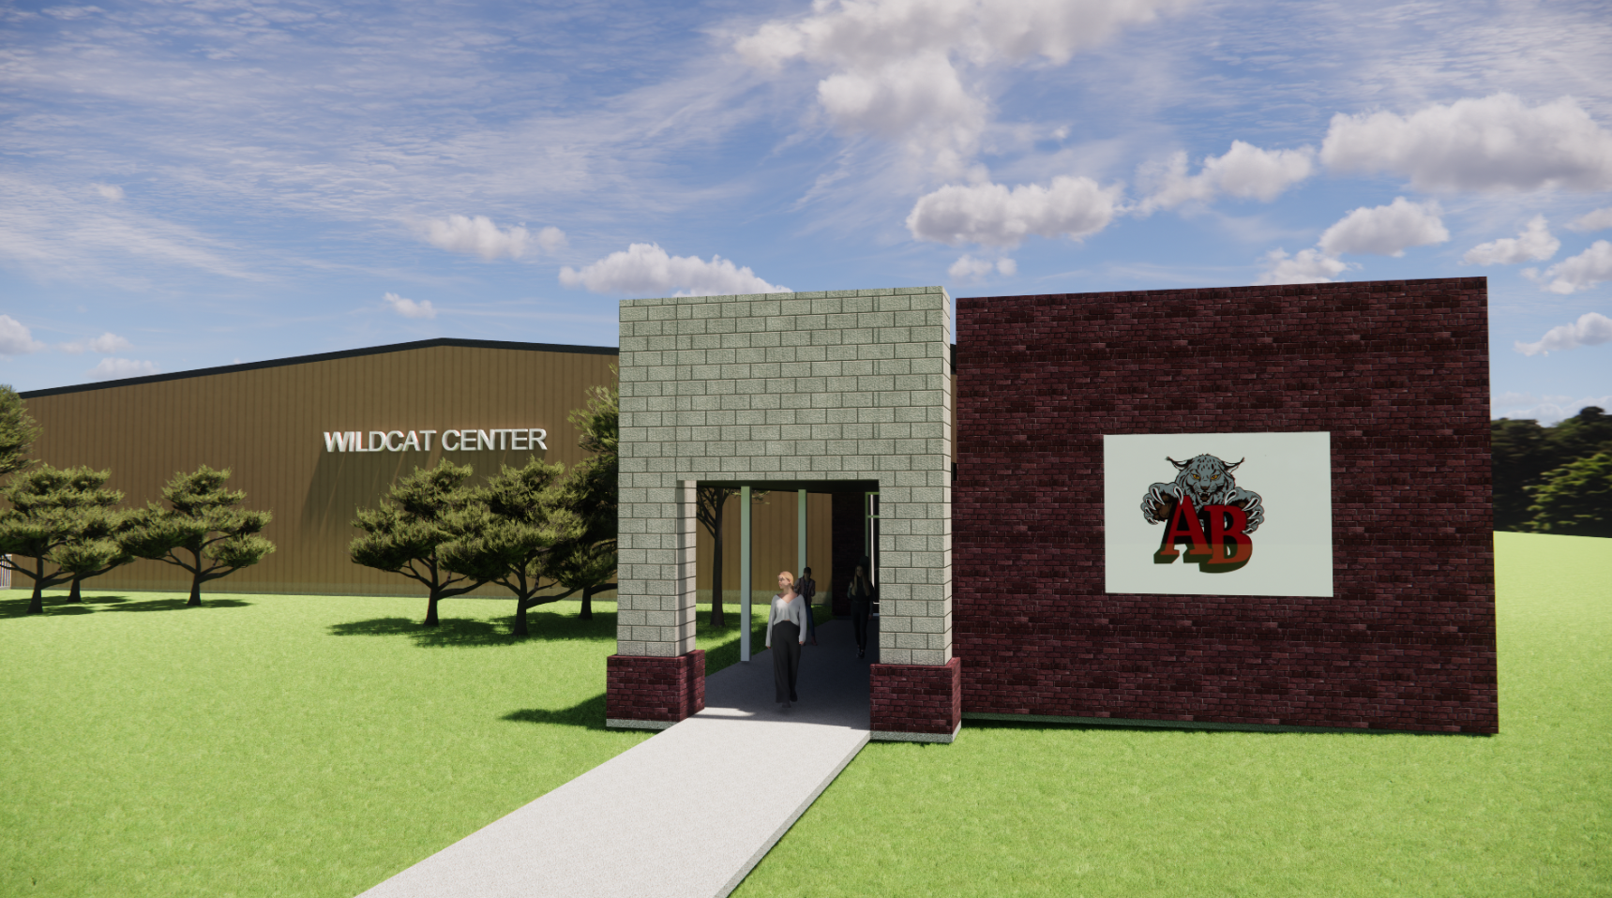
Allen Bowden
Activity Center Entry to Gym and Classrooms
Allen Bowden Activity Center

