Slide 1
Allen Bowden Public Schools
Bond Projects
Vote February 11, 2025 No Additional Taxes
Martin Design, Architects

Slide 2
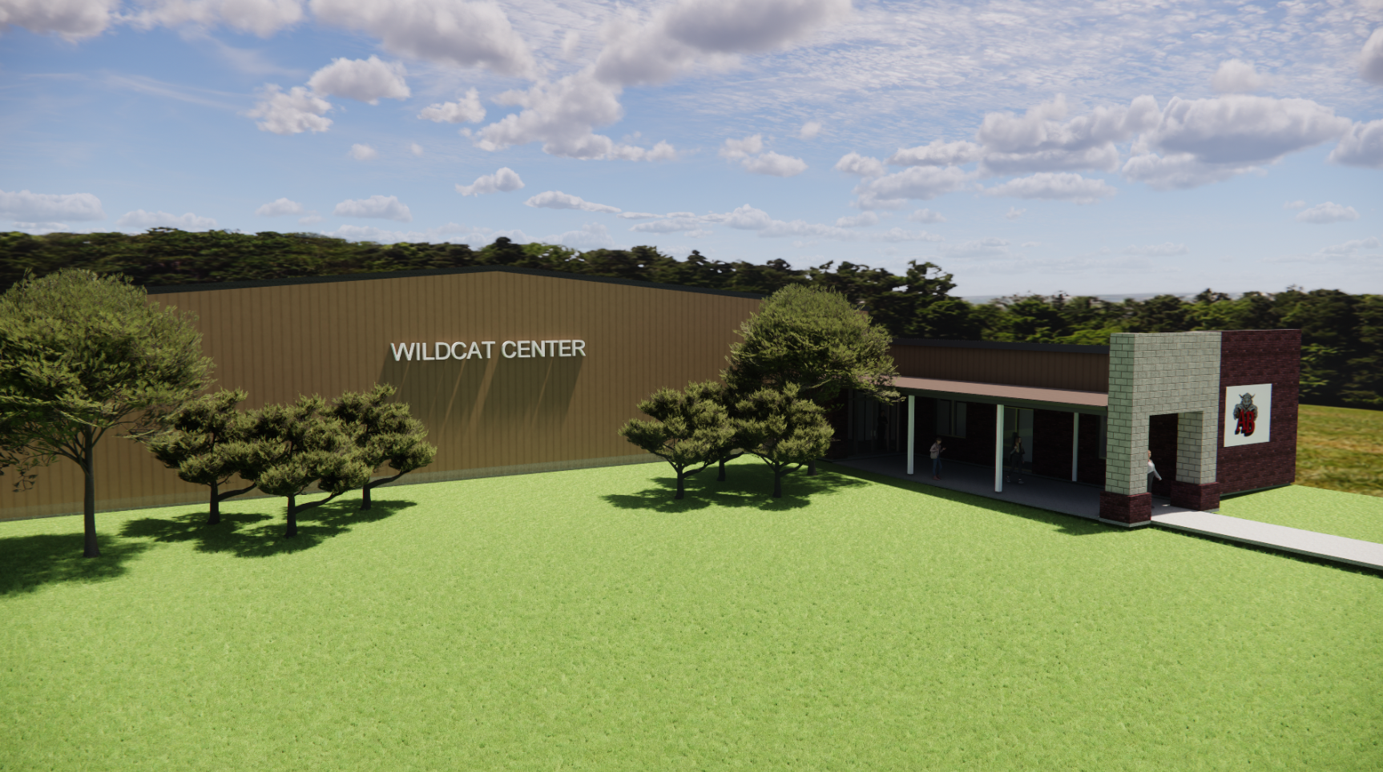
Activity Center
Allen Bowden School

Slide 3
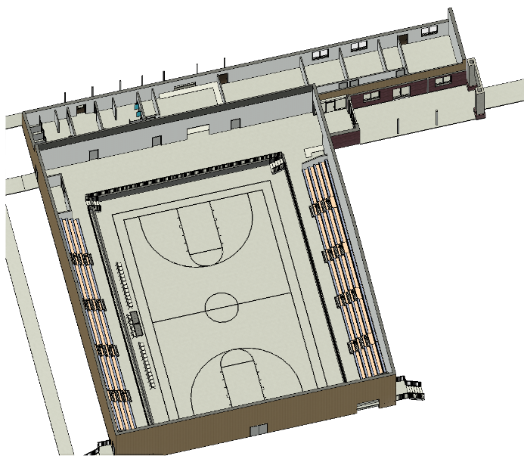
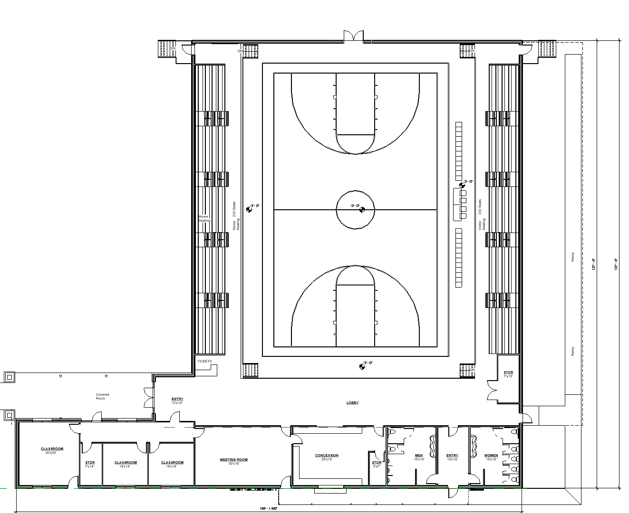
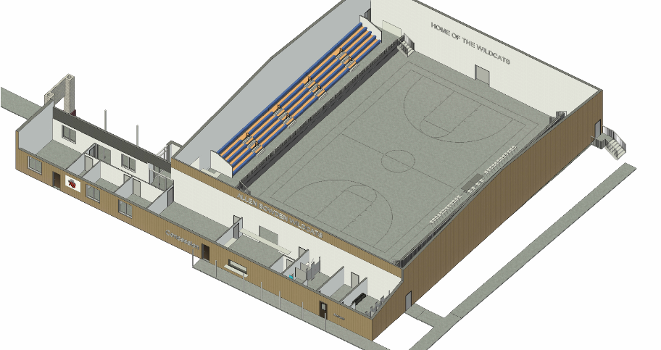
600 seats
Allen Bowden
Classroom/Dressing Rooms
Concession & Restrooms

Slide 4
Allen Bowden Activity Center

Slide 5
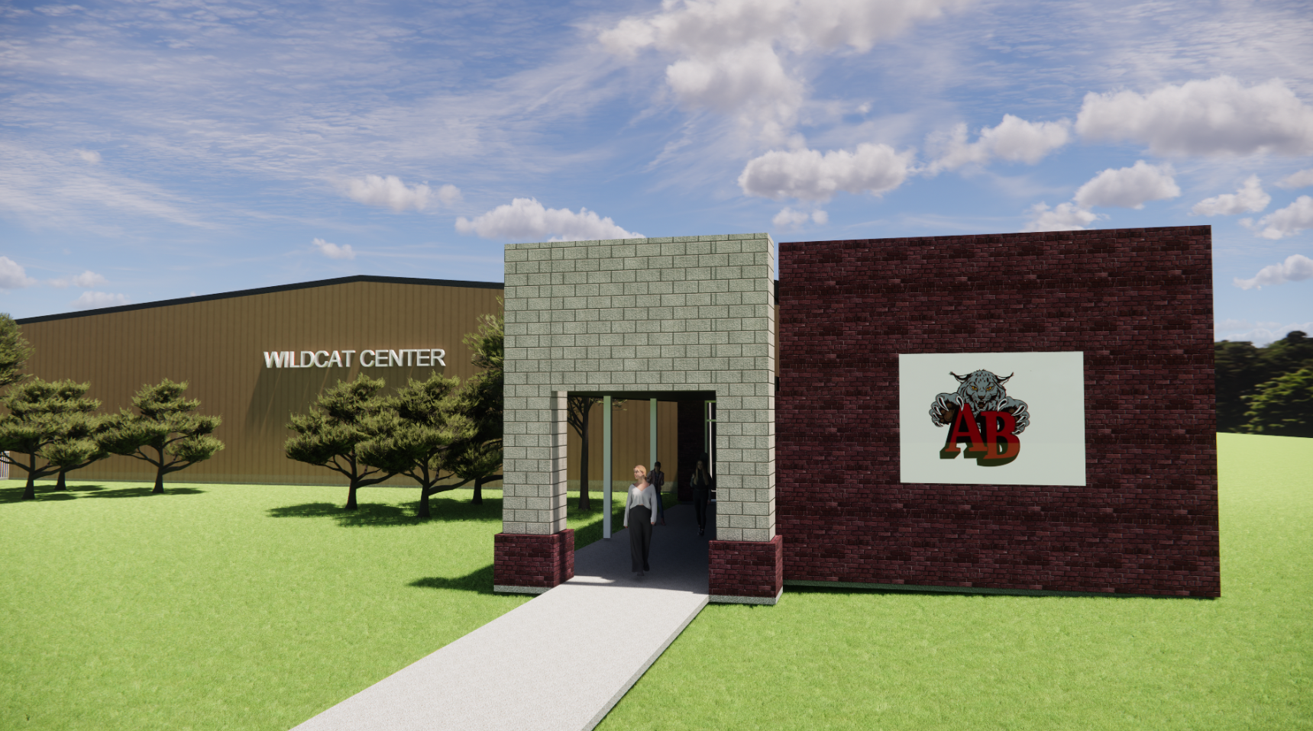
Allen Bowden
Activity Center Entry to Gym and Classrooms
Allen Bowden Activity Center

